Slide 1
My eXp
How to access and use the Global Revenue Share dashboard

Slide 2
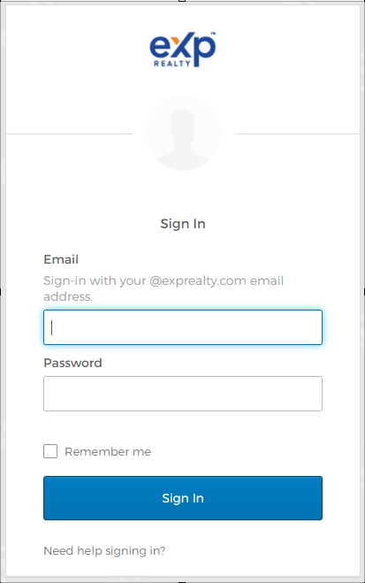
Log-In Page
Agent will log in using their OKTA Credentials

Slide 3
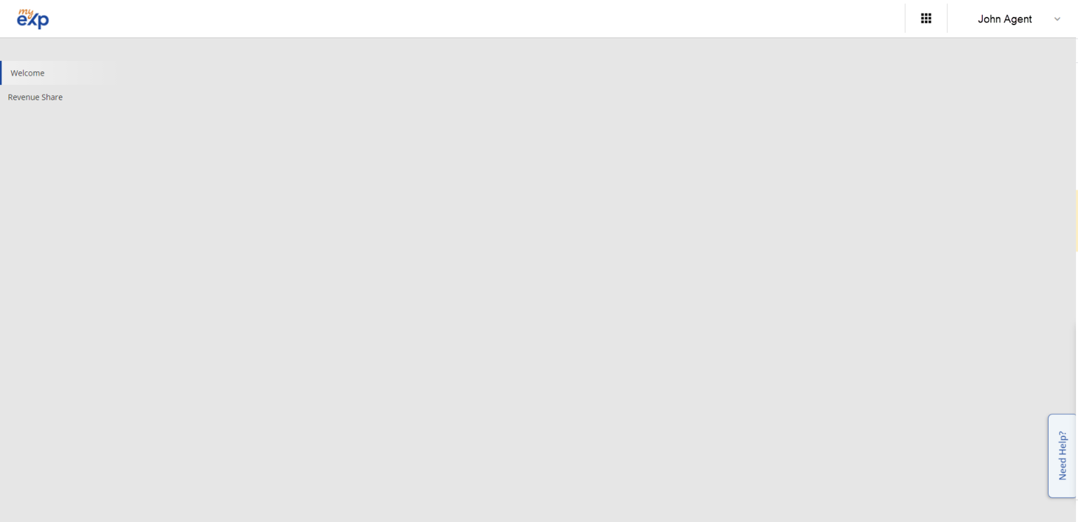
Welcome Page
Agent’s name will appear in top right corner.
Help Me Toggle will appear on all pages.

Slide 4
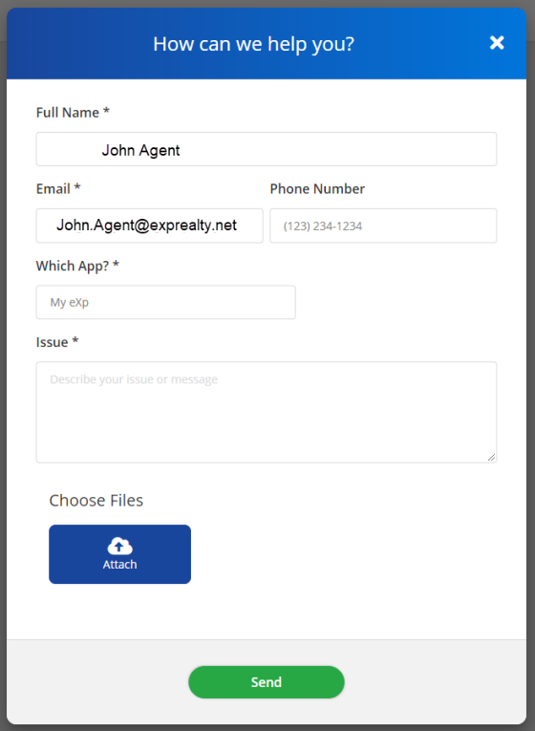
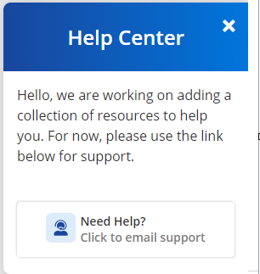

How to Email Support For Help
Click on “Click to email support” for pop-up email form
Pre-filled:
Name, Email and App will be auto populated
Click on “Need Help?” to expand
Issue Box: This is required. Describe the issue here.
Optional:
Agents can include a phone number and attachment.

Slide 5
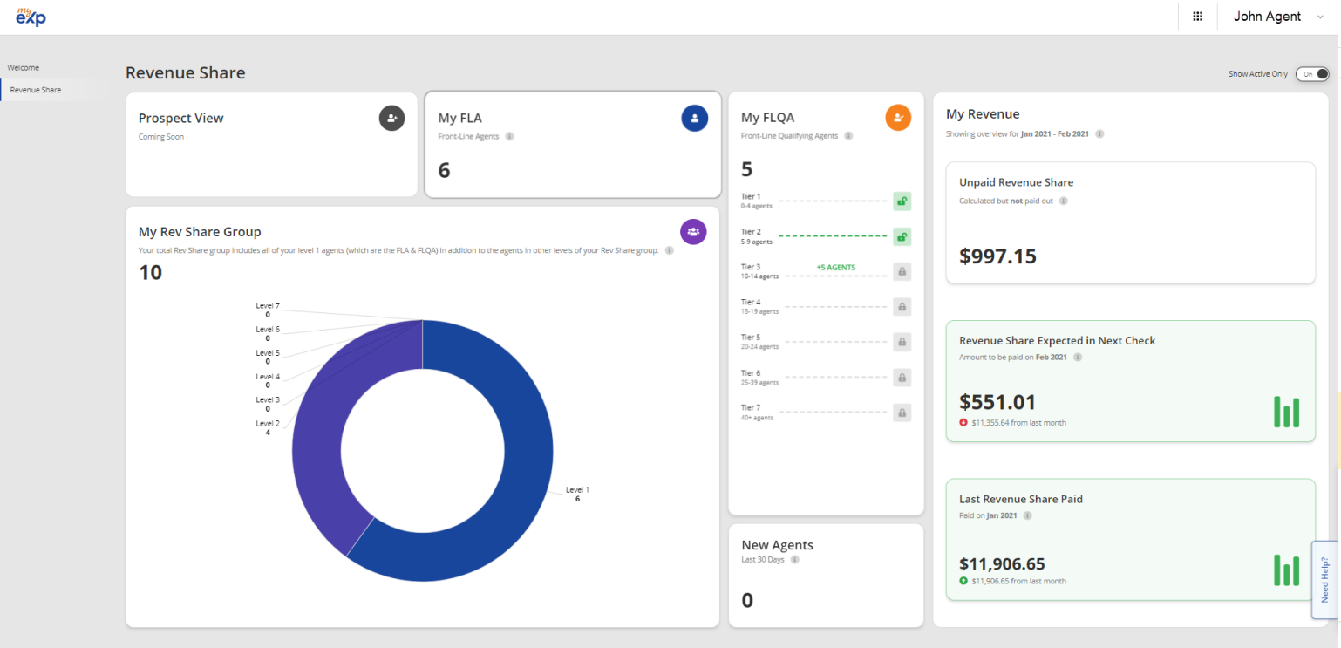
Revenue Share Dashboard
Click on “Revenue Share” to access dashboard.

Slide 6
Revenue Share Dashboard
Show Active Only:
Toggle to show only Active Agents or all Agents in applicable reports
My FLQA:
Shows FLQA Agent count and click for more information. Also, shows Tier of Exponential Rev share when unlocked
My FLA:
Shows count and is clickable for detail report
Prospect View:
Not active as of right now.
My Revenue:
Shows amount and is clickable for detailed report for each sub report
My Rev Share Group:
Shows counts for each Rev Share Level and is clickable for detail report
New Agents:
Shows agent count and is clickable for more information

Slide 7
Types of Reports and What They Report

Slide 8
Revenue Share Dashboard: My FLA
Report will show Level 1 Agents. The Reports will contain:
Main Row/Columns in Report:
Name
Phone
Status
Join Date
FLQA Expires (For agents who are also FLQA)
Transactions (Provides count of transactions and Gross Commission Income (GCI) for last 6 months - shown in currency of the producing agent)
Total RS (Provides Total Revenue Share Generated for User Agent for last 6 months - shown in currency of the user agent)
Click “View” For Extra Details:
Name
Agent ID
Anniversary Month
Mentor
Phone Number
Primary Email
Secondary Email
Address (City, State, Postal Code, Country)

Slide 9
Revenue Share Dashboard: My FLQA
Report will show Level 1 Agents who are “Qualified” status
Main Row/Columns in Report:
Name
Phone
Status
Join Date
FLQA Expires (Countdown of days)
Transactions (Provides count of transactions and Gross Commission Income (GCI) for last 6 months - shown in currency of the producing agent)
Total RS (Provides Total Revenue Share Generated for User Agent for last 6 months - shown in currency of the user agent)
Click “View” For Extra Details:
Name
Agent ID
Anniversary Month
Mentor
Phone Number
Primary Email
Secondary Email
Address (City, State, Postal Code, Country)

Slide 10
Revenue Share Dashboard: New Agents
Report will show all Agents from Rev Share Group joining in last 30 days
Main Row/Columns in Report:
Level
Name
Contact (Stacked Email and Phone number)
Sponsor Name
Location (Stacked State and Country)
Status
Join Date

Slide 11
Revenue Share Dashboard: My Revenue Share Group
Report will show all Agents in Rev Share Group
Main Row/Columns in Report:
Level
Name
Contact (Stacked Email and Phone number)
Sponsor Name
Location (Stacked State and Country)
Status
Join Date

Slide 12
Offboarding Summary
Report will show all Agents in Rev Share Group who have had an agents they directly sponsor offboard.
Main Row/Columns in Report:
Level
Name
Number of Offboarded Agents
Click “View” For Extra Details:
Level
Name
Joined
Offboarded
Number of Deals
Sum of Deals

Slide 13
Monthly Revenue Share Summary
Report will show a monthly overview of some key team metrics related to average counts and volume of production.
Main Row/Columns in Report:
Month/Year
REvShare
Number of Agent with Transactions
Average Agent
Average Transactions
Total Agents
Percent of Agent with Transactions
Percent of Change for Agents with Transactions

Slide 14
Revenue Share Dashboard: My Revenue
Report has 3 related reports showing details for “Unpaid Revenue Share”, “Revenue Share Expected In Next Check” and “Last Revenue Share Paid” as it is related to the 3 titles in the “My Revenue” section on the main dashboard.
Main Row/Columns in Report:
Level
Name
Location (Stacked State and Country
Sum
Click “View” For Extra Details:
Tran. ID
Tran. Status
Commission Base
Amount
Close Date
Paid Status
Second “View” Extra Details:
eXpansion Share
eXponential Share
Revenue Share
Company Commission
SRS Buffer Applied
SRS Buffer Percentage
Amount Before Applying SRS Buffer
Amount Deducted Due to Applying SRS Buffer
Amount

Slide 15
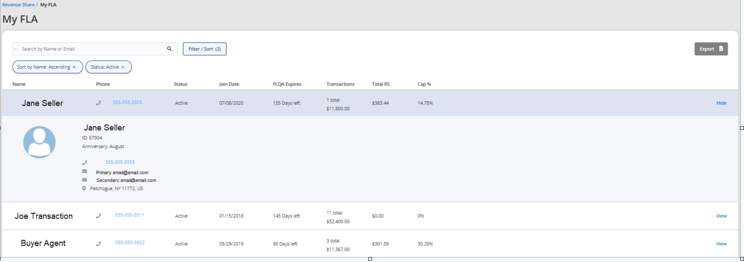
Report Details
Below is an example of a report. Each one that was mentioned previously will look like this:
Click “Export” to have copy of results sent via email. All Filters will be kept. Excel will contain the main row and all data from “View” section
Main
Row
Click “Hide” to remove additional details for agent.
Example of what “View”
looks like when clicked
Click “View” to see additional details for agent.

Slide 16
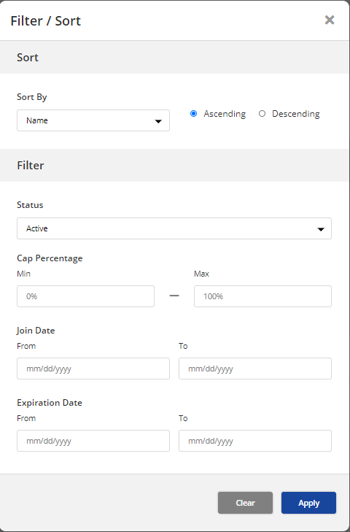
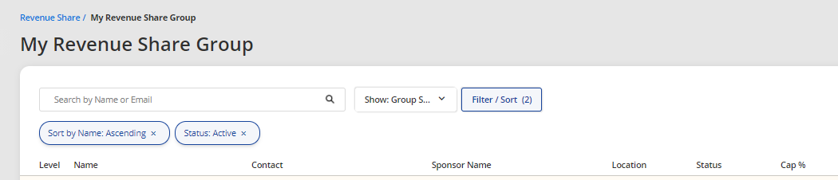
How to Sort Report and Filter Options
Bubbles contain all current filter and sort options. Click to remove.
Click to expand for Search and Filter Options
Search bar for
Agent Name and Email

Slide 17
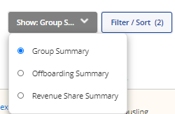
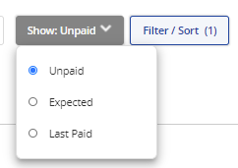
Accessing Sub or Related Reporting
Additional Reporting Dropdown Navigation
Main Report:
My Revenue Share Group
Sub Reports:
Offboard Summary
Monthly Revenue Share Summary
Main Reports:
Unpaid Revenue Share
Revenue Share Expected in Next Check
Last Revenue Share Paid
Related Reports:
Unpaid Revenue Share
Revenue Share Expected in Next Check
Last Revenue Share Paid

